Slide 1
Transistors and Biasing Methods
Unit-2

Slide 2
Contents:
Transistors:
Bipolar Junction Transistor
Transistor Voltages and Currents
Amplification
Common Base Characteristics
Common Emitter Characteristics
Common Collector Characteristics
DC Load Line and Bias Point

Slide 3
Contents:
Biasing Methods:
Base Bias
Collector to Base Bias
Voltage Divider Bias
Comparison of basic Bias Circuits

Slide 4
1. Bipolar junction Transistor (BJT)

Slide 5
Bipolar junction Transistor
A bipolar transistor is a semiconductor device in which electric current flows due to electrons and holes BOTH, simultaneously. Thus both types of charges take part in the conduction of current through it. Hence it is called bipolar transistor.
A bipolar junction transistor (BJT) consists of two PN junctions formed by sandwiching either p-type or n-type semiconductor between a pair of opposite types.

Slide 6
Bipolar junction Transistor
These are two types 1. NPN 2. PNP transistor
The outer layers of the npn or pnp sandwich are called the emitter and the collector, and the centre layer is termed the base.
Two pn junctions are formed with depletion regions and barrier voltages at each junction.

Slide 7
Bipolar junction Transistor (or) Operation of PNP or NPN
A transistor (PNP or NPN) has three sections of doped semiconductors.
It consists of 3 terminals
1.Emitter 2. Base 3. Collector
Section on one side that supplies charge carriers (electrons of holes) is called emitter. Which is heavily doped .
The middle section which form two pn-junctions between the emitter and collector is called the base.

Slide 8
Bipolar junction Transistor
The section on the other side that collects the charges is called the collector . Collector junction is always reverse biased. This section is moderately doped.
Where as emitter is heavily doped so that it can inject a large number of charge carriers into the base.
The base is lightly doped and very thin.
The resistance of emitter diode is small and collector diode is large.
Therefore the transistor transfers the input signal current from a low-resistance circuit to a high-resistance circuit.

Slide 9
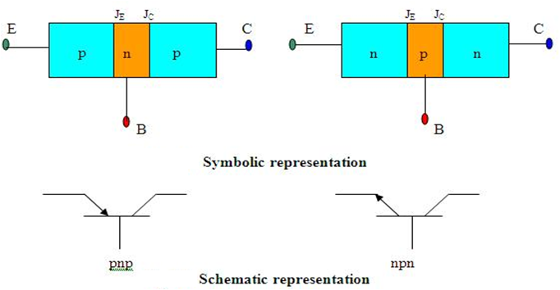
The base section is made as narrow as possible so that charge carriers can easily move across from emitter to collector.
The base is lightly doped, so that few charge carriers are available to recombine with the majority charge carriers from the emitter.
Most charge carriers from the emitter flow to the collector, a few flow out through the base terminal.

Slide 10
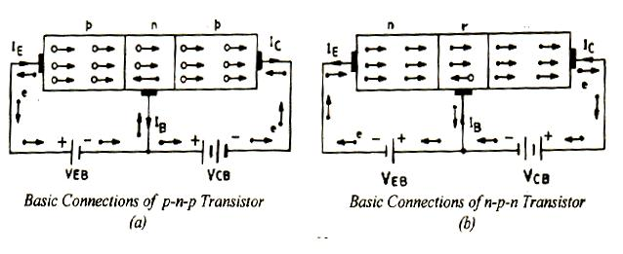
Operation of NPN and PNP

Slide 11
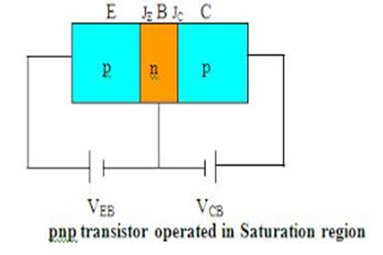
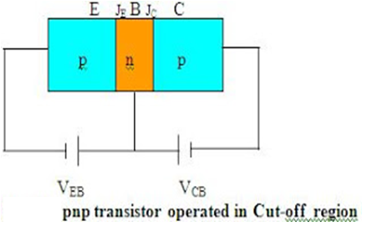
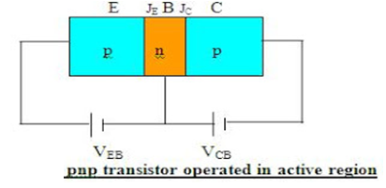
Transistor operating regions.

Slide 12
A transistor can be operated in three different regions as
a) Active region b) Saturation region c) Cut-off region
Active region: The transistor is said to be operated in active region when the emitter-base junction is forward biased and collector –base junction is reverse biased.
The collector current is said to have two current components one is due to the forward biasing of EB junction and the other is due to reverse biasing of CB junction.
The collector current component due to the reverse biasing of the collector junction is called reverse saturation current (I_{CO} or I_{CBO}) and it is very small in magnitude.

Slide 13
Saturation Region:
Transistor is said to be operated in saturation region when both EB junction and CB junction are forward biased as shown. When transistor is operated in saturation region I_{C} increases rapidly for a very small change in V_{C.}
Cut-off region:
When both EB junction and CB junction are reverse biased, the transistor is said to be operated in cut-off region. In this region, the current in the transistor is very small and thus when a transistor in this region it is assumed to be in off state.

Slide 14
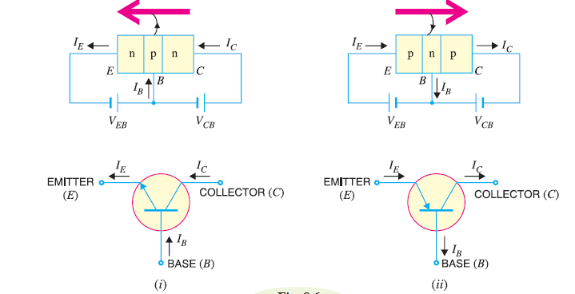
2. Transistor Voltages and Currents

Slide 15
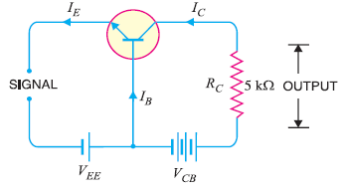
3. Amplification
A transistor raises the strength of a weak signal and thus acts as an amplifier.
The weak signal is applied between emitter-base junction and output is taken across the load R_{c} connected in the collector circuit.
The input circuit should always remain forward biased. To do so, a dc voltage V_{EE} is applied in the input circuit in addition to the signal.

Slide 16
Amplification
This dc voltage is known as bias voltage and its magnitude is such that it always keeps the input circuit forward biased regardless of the polarity of the signal.
As the input circuit has low resistance, therefore, a small change in signal voltage causes and appreciable change in I_{E.} This causes almost the same change in I_{C} due to transistor action. The collector current flowing through a high load resistance R_{C} produces a large voltage across it. Thus a weak signal applied in the input circuit appears in the amplified form in the collector circuit.
In this way the transistor acts as an amplifier.

Slide 17
4. COMMON BASE CHARACTERISTICS

Slide 18
Common base characteristics
A pnp transistor with its base terminal common to both the input (emitter-base) terminal and the output (collector-base) terminal.
The transistor is said to be connected in common-base configuration.
Voltmeters and ammeters are used to measure the input and output voltages and currents.

Slide 19
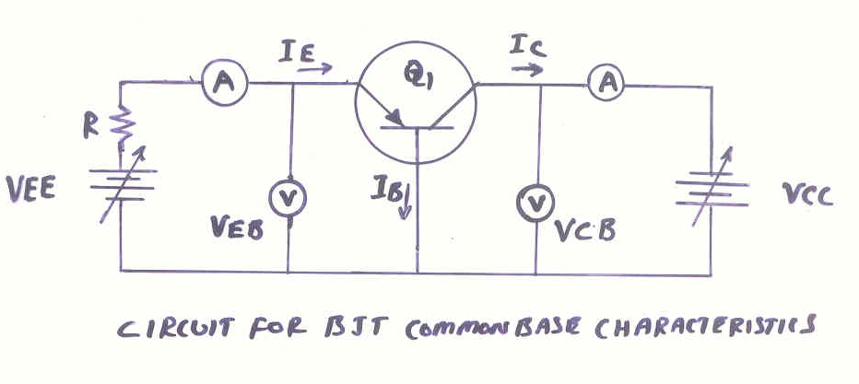

Slide 20
Common-Base Input characteristics
To investigate the input characteristics, the output voltage (V_{CB}) is kept constant, and the input voltage (V_{EB}) is set at several convenient levels.
At each input voltage, the corresponding input current (I_{E}) is recorded.
The I_{E} and V_{EB} levels are then plotted to give the common-base input Characteristics.

Slide 21
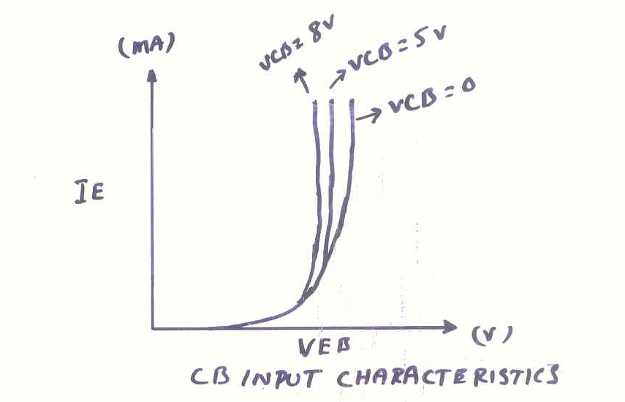
Input Characteristics

Slide 22
Common base Output characteristics
To investigate output characteristics, the input current (I_{E}) is kept constant, and V_{CB} is adjusted in convenient steps, and the corresponding values of I_{C} are recorded.
The corresponding I_{C} and V_{CB} levels obtained when I_{E} was held constant at 1 m A are potted, and the resultant characteristic is identified as I_{E} =1mA. Similarly other characteristics are potted for I_{E} equal to 2mA, 3mA, and so on

Slide 23
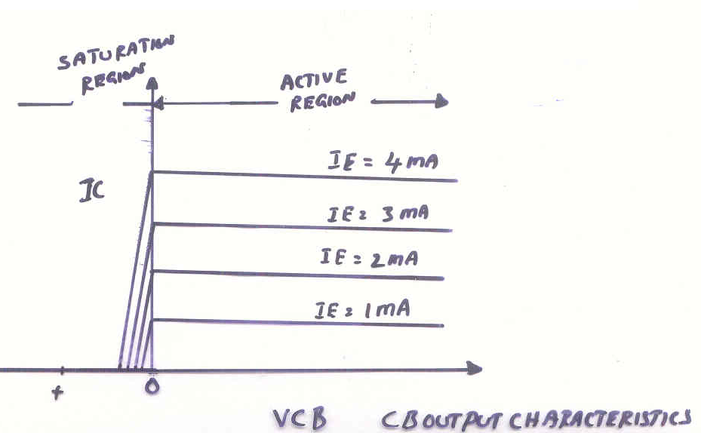
Output Characteristics

Slide 24
5. COMMON EMITTER CHARACTERISTICS

Slide 25
COMMON-EMITTER CHARACTERISTCS
A pnp transistor with its Emitter terminal common to both the input (base-emitter) terminal and the output (collector-emitter) terminal.
The transistor is said to be connected in common-emitter configuration.
Voltmeters and ammeters are used to measure the input and output voltages and currents.

Slide 26
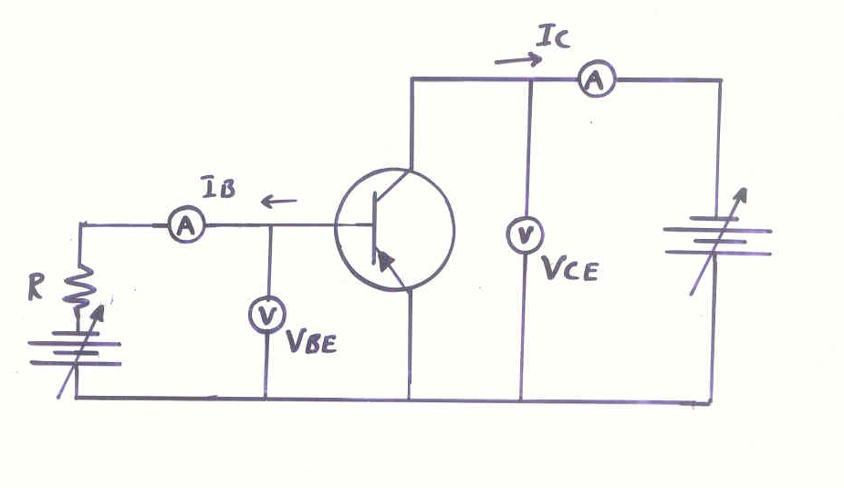

Slide 27
Common-Emitter Input Characteristics
To investigate the input characteristics, the output voltage (V_{CE}) is kept constant, and the input voltage (V_{BE}) is set at several convenient levels.
At each input voltage, the corresponding input current (I_{B}) is recorded.
The I_{B} and V_{BE} levels are then plotted to give the common-emitter input Characteristics.

Slide 28
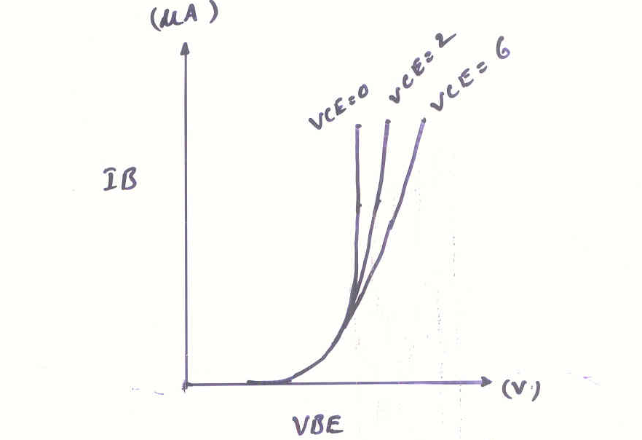

Slide 29
Common Emitter output characteristics
To investigate output characteristics, the input current (I_{B}) is kept constant, and V_{CE} is adjusted in convenient steps, and the corresponding values of I_{C} are recorded.
The corresponding IC and VCE levels obtained when IB was held constant at 10 µ A are potted, and the resultant characteristic is identified as IB=10 µ A. Similarly other characteristics are potted for IB equal to 20 µ A, 30 µ A, and so on.

Slide 30
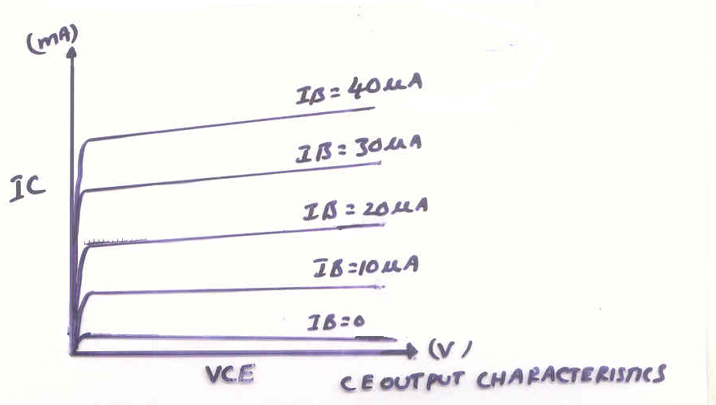

Slide 31
6. COMMON COLLECTOR CHARACTERISTICS

Slide 32
COMMON COLLECTOR CHARACTERISTICS
In this circuit the base terminal of the transistor serves as the input, the emitter is the output, and the collector is common to both.
Signal input between base and common collector.
Signal output between emitter and common collector.
The CC circuit is also known as an emitter follower since the output voltage at the emitter follows the input voltage at the base.
It has voltage gain slightly less than unity.

Slide 33
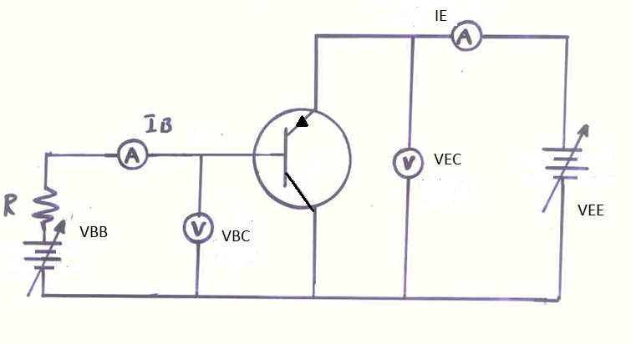

Slide 34
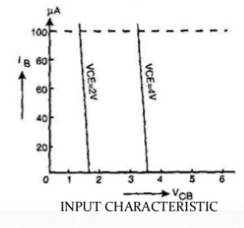
Common Collector Input Characteristics
The CC input characteristics are quite different from CB & CE characteristics.
This is because input voltage VBC is largely determined by output voltage VEC
V_{EB} =V _{EC} - V_{BC}
As VBC increases with VEC constant VEB decreases hence IB decreases.

Slide 35
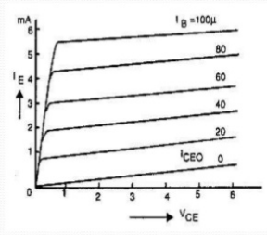
Common Collector Output Characteristics
Here VCE increases IE also increases.
Just as in common emitter output characteristics IC increases with increasing IB ,so IE also increases here with increasing IB.
Hence for constant VEC, IE increases with IB

Slide 36
α is common base current gain
α dc = IC / IE
β is common emitter current gain
β = IC / IB
IC = α dc ( IC + IB)
IC = α dc IB / 1- α dc
IC = β dc IB
β = α dc / 1- α dc

Slide 37
Early Effect
An increase in magnitude of collector voltage increases (reverse bias) the space charge width increase at the output junction diode (C-B junction). Such action causes the effective base width ‘W’ to decreases. This phenomenon is known as ‘Early Effect’

Slide 38
Punch-through (or) Reach -through
If an excessive reverse-bias voltage is applied to the collector-base junction, the device breakdown may occur.
Breakdown can also result from the collector-base depletion region penetrating into the base (as the reverse bias increases) until it makes contact with emitter-base depletion region.
This condition is known as punch through or reach through
A Very large currents can flow when it occurs, possible destroying the device.

Slide 39
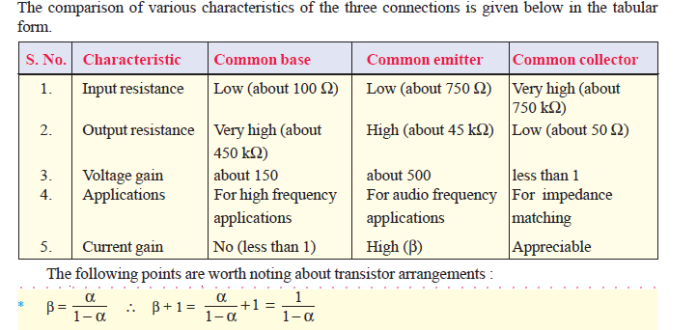

Slide 40
Thermal run away

Slide 41
Thermal run away
The Junction temperature may rise either because of the ambient temperature or because of self heating.
As the junction temperature increases, Ico increases which will further increase I_{c . Again} heat dissipates causing the temperature to increase.
It is a cumulative process Which will cause the transistor to burn out.

Slide 42
Transistor as a switching
Transistor can be used as a switch
For obtaining switching characteristics saturation and cutoff regions are taken into consideration.
Saturation region is known as on condition of a switch.
cutoff region is known as off condition of a switch.

Slide 43
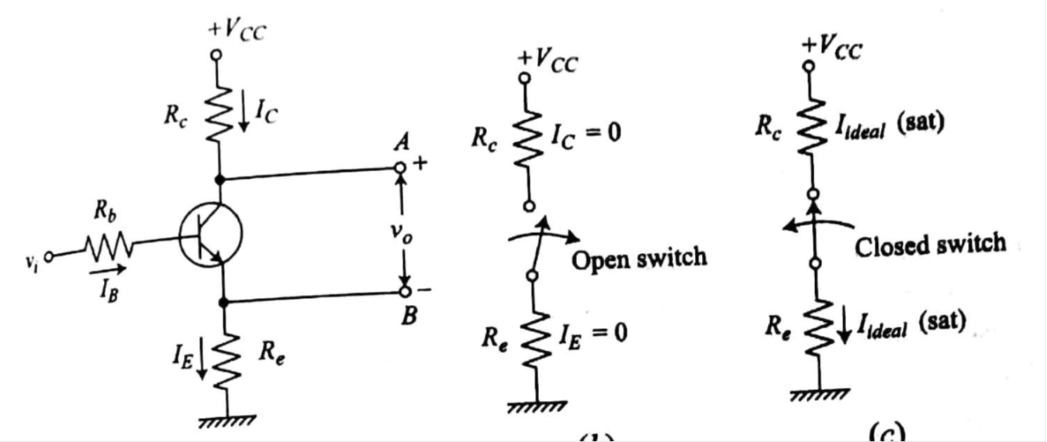

Slide 44
Transistor Switching timings

Slide 45
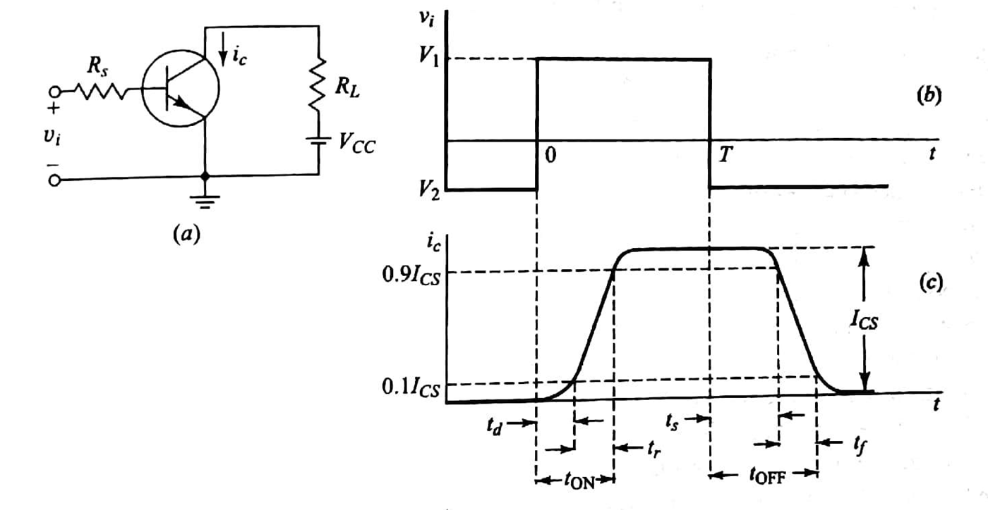

Slide 46
Transistor switching timings
Current does not Respond to input signal. There exists certain time delay.
Delay time t_{d}
The delay time that elapses with the time required for the current to rise 10 % of maximum value is called delay time.
Rise time t_{r}
IT is the time required for the current to rise from 10 % of its maximum value to 90 % of its maximum value.

Slide 47
Transistor switching timings
Storage time t_{s} :
The interval Which elapses the transition of input wave form and The time when I_{C} has dropped to 90% of maximum value is called storage time t_{s .}
Fall time t_{f} :
The time required to fall from 90% of its maximum value to 10% of maximum value is known as fall time t_{f} .

Slide 48
Transistor switching timings:
Transistor switching timings are
Delay time (td)
Rise time (tr)
Turn on time (ton) : (ton) = (td)+ (tr)
It is the sum of delay time and rise time.
Turn off time (t off): (toff)= (ts)+ (tf)
Storage time (ts)
Fall time (tf)
Turn off time is the combination storage time and fall time

Slide 49
Transistor Biasing
The basic function of transistor is amplification. The process of raising the strength of weak signal without any change in its general shape is referred as faithful amplification. For faithful amplification it is essential that:-
Emitter-Base junction is forward biased
Collector- Base junction is reversed biased
Proper zero signal collector current
The proper flow of zero signal collector current and the maintenance of proper collector emitter voltage during the passage of signal is called transistor biasing.

Slide 50
WHY BIASING?
If the transistor is not biased properly, it would work inefficiently and produce distortion in output signal.
HOW A TRANSISTOR CAN BE BIASED?
A transistor is biased either with the help of battery or associating a circuit with the transistor. The later method is more efficient and is frequently used. The circuit used for transistor biasing is called the biasing circuit.

Slide 51
BIAS STABILITY
Through proper biasing, a desired quiescent operating point of the transistor amplifier in the active region (linear region) of the characteristics is obtained. It is desired that once selected the operating point should remain stable. The maintenance of operating point stable is called Stabilization.
The operating point of a transistor amplifier shifts mainly with changes in temperature, since the transistor parameters — β, I_{CO} and V_{BE} are functions of temperature.

Slide 52
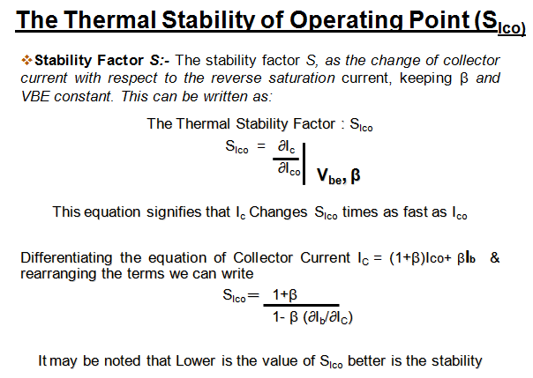

Slide 53
7. A generic dc load line.

Slide 54
Example
Plot the dc load line for the circuit shown in Fig

Slide 55
Example
Plot the dc load line for the circuit shown in Fig. Then, find the values of V_{CE} for I_{C} = 1, 2, 5 mA respectively.
I_{C} (mA) | V_{CE} (V)
1 | 9
2 | 8
5 | 5

Slide 56
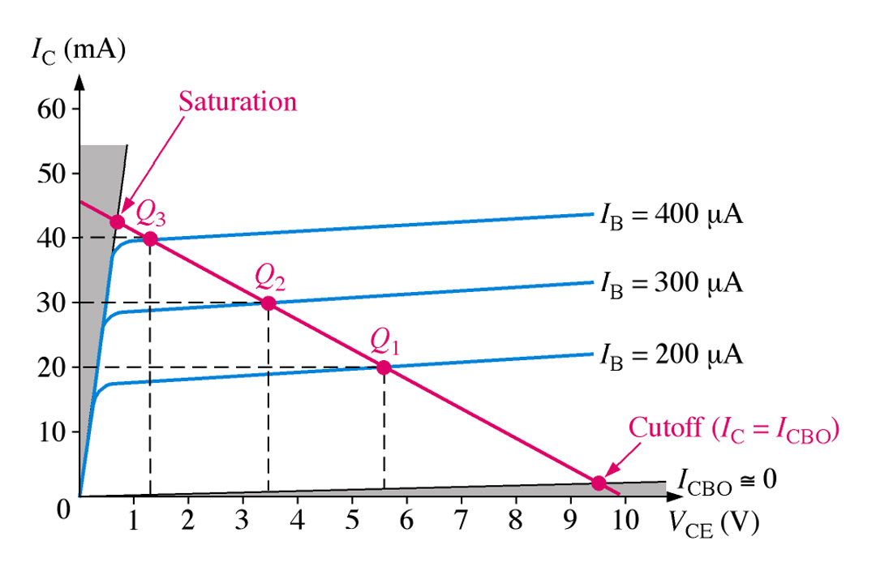
The DC Operating Point
For a transistor circuit to amplify it must be properly biased with dc voltages. The dc operating point between saturation and cutoff is called the Q-point. The goal is to set the Q-point such that that it does not go into saturation or cutoff when an a ac signal is applied.

Slide 57
1. Base bias (fixed bias).
β = dc current gain = h_{FE}

Slide 58
Example
The circuit is midpoint biased.

Slide 59
Example
Construct the dc load line for the circuit shown in Fig and plot the Q-point from the values obtained in Example .Determine whether the circuit is midpoint biased.

Slide 60
Base bias characteristics.
Circuit recognition: A single resistor (R_{B}) between the base terminal and V_{CC}. No emitter resistor.
Advantage: Circuit simplicity.
Disadvantage: Q-point shift with temp.
Applications: Switching circuits only.

Slide 61
Base bias characteristics.
Load line equations:
Q-point equations:

Slide 62
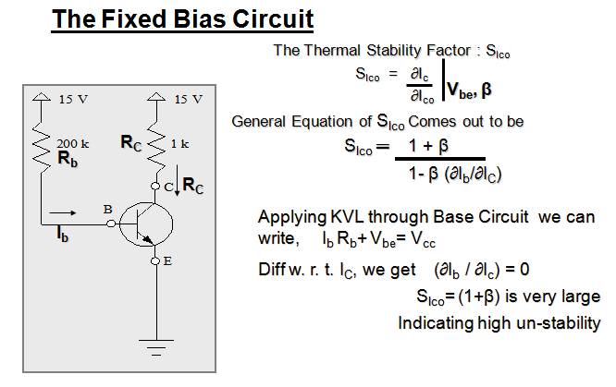

Slide 63
2. Collector-feedback bias.

Slide 64
Example
Determine the values of I_{CQ} and V_{CEQ} for the amplifier shown in Fig.

Slide 65
Circuit Stability of Collector-Feedback Bias
h_{FE} increases
I_{C} increases (if I_{B} is the same)
V_{CE} decreases
I_{B} decreases
I_{C} does not increase that much.
Good Stability. Less dependent on h_{FE} and temperature.

Slide 66
Collector-Feedback Characteristics
Q-point relationships:

Slide 67
Collector-Feedback Characteristics
Circuit recognition: The base resistor is connected between the base and the collector terminals of the transistor.
Advantage: A simple circuit with relatively stable Q-point.
Disadvantage: Relatively poor ac characteristics.
Applications: Used primarily to bias linear amplifiers.

Slide 68
Thermal stability factor of collector feedback bias

Slide 69
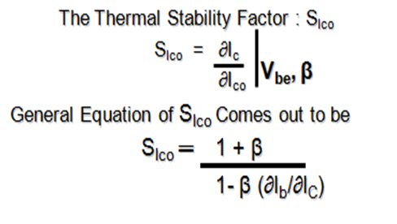
Applying KVL through base circuit
we can write (I_{b}+ I_{C}) R_{C} + I_{b} R_{b}+ V_{be}= V_{cc}
Diff. w. r. t. I_{C} we get
(∂I_{b} / ∂I_{c}) = - R_{C} / (R_{b} + R_{C})
Therefore, S_{Ico} ═ (1+ β)
1+ [βR_{C}/(R_{C}+ R_{b})]
Which is less than (1+β), signifying better thermal stability

Slide 70
3. Voltage divider bias
Assume that I₂ > 10I_{B}.
Assume that I_{CQ} @ I_{E} (or h_{FE} >> 1). Then

Slide 71
Example
Determine the values of I_{CQ} and V_{CEQ} for the circuit shown in Fig.
Because I_{CQ} @ I_{E} (or h_{FE} >> 1),

Slide 72
Example
Verify that I₂ > 10 I_{B}.

Slide 73
Stability of Voltage Divider Bias Circuit
The Q-point of voltage divider bias circuit is less dependent on h_{FE} than that of the base bias (fixed bias).
For example, if I_{E} is exactly 10 mA, the range of h_{FE} is 100 to 300. Then
I_{CQ} hardly changes over the entire range of h_{FE}.

Slide 74
Voltage-divider bias characteristics
Circuit recognition: The voltage divider in the base circuit.
Advantages: The circuit Q-point values are stable against changes in h_{FE}.
Disadvantages: Requires more components than most other biasing circuits.
Applications: Used primarily to bias linear amplifier.

Slide 75
Voltage-divider bias characteristics
Load line equations:
Q-point equations (assume that h_{FE}R_{E} > 10R₂):

Slide 76
Thermal stability factor of voltage divider bias

Slide 77
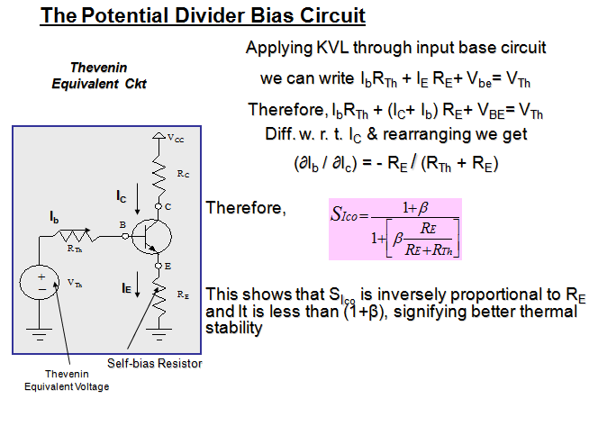

Slide 78
4.Comparison of Bias Circuits
Parameter | Fixed Bias | Feedback Bias | Self Bias
Stability | 1+β | <1+β | 1
Complexity | Simple (requires only R_{B)} | Simple (requires only R_{B)} | Requires R₁ ,R₂ and R_{E} .
Usage | Switching Circuits | Used in circuits which should not drive transistor into saturation | Universal bias circuit. (always preferred)
Stability factor | S=1+β | S=1+β / 1+β(RC/RC+RB) | S=1+β / 1+β(RE/RE+RT)

Slide 79
The End

